Slide 1
Alligation
and
Mixture

Slide 2
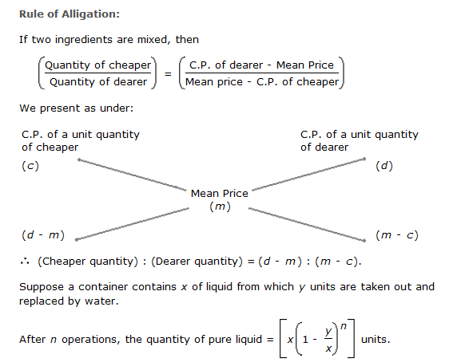
Alligation and Mixture

Slide 3
Alligation and Mixture
1. In what ratio water must be mixed with fruit juice costing Rs 24 /Ltr so that the juice would be worth of Rs 20/ltr? a.1:4 b.1:5 c.1:6 d.2:5

Slide 4
Alligation and Mixture
1. In what ratio water must be mixed with fruit juice costing Rs 24 /Ltr so that the juice would be worth of Rs 20/ltr? a.1:4 b.1:5 c.1:6 d.2:5

Slide 5
Alligation and Mixture
2. How many litres of a 90% solution of concentrated acid needs to be mixed with a 75% solution of concentrated acid to get a 30 litre solution of 78% concentrated acid? a.24L b.22.5L c.6L d.17.5L

Slide 6
Alligation and Mixture
2. How many litres of a 90% solution of concentrated acid needs to be mixed with a 75% solution of concentrated acid to get a 30 litre solution of 78% concentrated acid? a.24L b.22.5L c.6L d.17.5L

Slide 7
Alligation and Mixture
3. A chemist mixes two liquids 1 and 2. One litre of liquid 1 weighs 1 kg and one litre of liquid 2 weighs 800 gm. If half litre of the mixture weighs 480 gm, then the percentage of liquid 1 in the mixture, in terms of volume, is? b.96 b.102 c.80 d.70

Slide 8
Alligation and Mixture
3. A chemist mixes two liquids 1 and 2. One litre of liquid 1 weighs 1 kg and one litre of liquid 2 weighs 800 gm. If half litre of the mixture weighs 480 gm, then the percentage of liquid 1 in the mixture, in terms of volume, is? b.96 b.102 c.80 d.70

Slide 9
Alligation and Mixture
4. One glass has juice and water in the ratio 5:2 while other glass has them in the ratio 7:4 respectively. If both glasses poured in a vessel, then what will be final ratio of water to juice in the vessel? a.8:35 b.52:25 c.35:8 d.25:52

Slide 10
Alligation and Mixture
4. One glass has juice and water in the ratio 5:2 while other glass has them in the ratio 7:4 respectively. If both glasses poured in a vessel, then what will be final ratio of water to juice in the vessel? a.8:35 b.52:25 c.35:8 d.25:52

Slide 11
Alligation and Mixture
5. A milk vendor has 2 cans of milk. The first contains 25% water and the rest milk. The second contains 50% water. How much milk should he mix from each of the containers so as to get 12 litres of milk such that the ratio of water to milk is 3 : 5? a.5,7 b.7,4 c.6,6 d.4,8

Slide 12
Alligation and Mixture
5. A milk vendor has 2 cans of milk. The first contains 25% water and the rest milk. The second contains 50% water. How much milk should he mix from each of the containers so as to get 12 litres of milk such that the ratio of water to milk is 3 : 5? a.5,7 b.7,4 c.6,6 d.4,8

Slide 13
Alligation and Mixture
6. Tea worth Rs. 126 per kg and Rs. 135 per kg are mixed with a third variety of tea in the ratio 1 : 1 : 2. If the mixture is worth Rs. 153 per kg, what is the price of the third variety per kg?
a. Rs. 175.50 B. Rs.170 C. Rs. 184 D. Rs. 150

Slide 14
Alligation and Mixture
6. Tea worth Rs. 126 per kg and Rs. 135 per kg are mixed with a third variety of tea in the ratio 1 : 1 : 2. If the mixture is worth Rs. 153 per kg, what is the price of the third variety per kg?
a. Rs. 175.50 B. Rs.170 C. Rs. 184 D. Rs. 150

Slide 15
Alligation and Mixture
7. In a test , a student gets 2 marks for every correct answer and 0.5 is deducted for every wrong answer. If the test consists of 100 questions and the student gets 120 marks, find number of wrong questions he did.(if student attempt all question).
a.34 b.28 c.32 d.12

Slide 16
Alligation and Mixture
7. In a test , a student gets 2 marks for every correct answer and 0.5 is deducted for every wrong answer. If the test consists of 100 questions and the student gets 120 marks, find number of wrong questions he did.(if student attempt all question).
a.34 b.28 c.32 d.12

Slide 17
Alligation and Mixture
8. A mixture of 40 litres of milk and water contains 10% of water. How much water is to be added to the mixture so that the water may be 20% in the new mixture.
a.5 b.4 c.6.5 d.7.5

Slide 18
Alligation and Mixture
8. A mixture of 40 litres of milk and water contains 10% of water. How much water is to be added to the mixture so that the water may be 20% in the new mixture.
a.5 b.4 c.6.5 d.7.5

Slide 19
Alligation and Mixture
9. A 20 litre mixture contains milk and water in the respective ratio of 3 : 2. Then 10 litres of the mixture is removed and replaced with pure milk and the operation is repeated once more. At the end of the two removals and replacements, what is the ratio of milk and water in the resultant mixture respectively? a.2:8 b.9:1 c.7:3 d.5:4

Slide 20
Alligation and Mixture
9. A 20 litre mixture contains milk and water in the respective ratio of 3 : 2. Then 10 litres of the mixture is removed and replaced with pure milk and the operation is repeated once more. At the end of the two removals and replacements, what is the ratio of milk and water in the resultant mixture respectively? a.2:8 b.9:1 c.7:3 d.5:4

Slide 21
Alligation and Mixture
10. A 63 liter mixture contains milk and water in a ratio of 4:5. then x liters of milk and y liters of water are added to the mixture, resulting in a milk to water ratio of 7:5. Finally , 60 liters of the mixture are drained and replaced with 60 liters of water, resulting in a milk to water ratio of 7:8. What is the value of x+y ?​ a.237 b.177.92 c.151.28 d.173.35

Slide 22
Alligation and Mixture
10. A 63 liter mixture contains milk and water in a ratio of 4:5. then x liters of milk and y liters of water are added to the mixture, resulting in a milk to water ratio of 7:5. Finally , 60 liters of the mixture are drained and replaced with 60 liters of water, resulting in a milk to water ratio of 7:8. What is the value of x+y ?​ a.237 b.177.92 c.151.28 d.173.35

Slide 23
MIXTURE AND ALLIGATION
Any Doubts???

